Slide 1
Readmission of Diabetic Patients
IE 7374 ML Final Project
Group 15:
Anurag Kosana
Mohith Kota
Manasa Valluru
Vignan Vennampally

Slide 2
Introduction
Diabetes is a severe chronic disease where a person suffers from an extended level of blood glucose in the body. Around 7% of the population worldwide are suffering with Diabetes.
The present analysis of a large clinical database was undertaken to examine historical patterns of diabetes care in patients with diabetes admitted to a US hospital and to inform future directions which might lead to improvements in patient safety.
We will be determining the readmission of patients to the hospitals after their medication during the first visit.

Slide 3
Problem Definition
The goal is to predict the chances of readmission of patients to the hospital considering certain changes in medication procedures, length of stay at the hospital, HbA1c measurement, age group, and multiple factors.
Patients are classified into 2 classes – Readmitted in less than 30 days or not
The class of interest is People readmitting before 30 days. Reducing early hospital readmissions is a policy priority aimed at improving healthcare quality.
Hence, This is a Classification Problem

Slide 4
Data Description
The dataset represents 10 years (1999-2008) data of clinical care at 130 US hospitals.
Dataset has 100000 records and 50 features – 37 categorical and 13 numerical features.
Information was extracted from the database for encounters that satisfied the following criteria:
It is an inpatient encounter (a hospital admission).
It is a diabetic encounter, that is, one during which any kind of diabetes was entered into the system as a diagnosis.
The length of stay was at least 1 day and at most 14 days.
Laboratory tests were performed during the encounter.
Medications were administered during the encounter

Slide 5
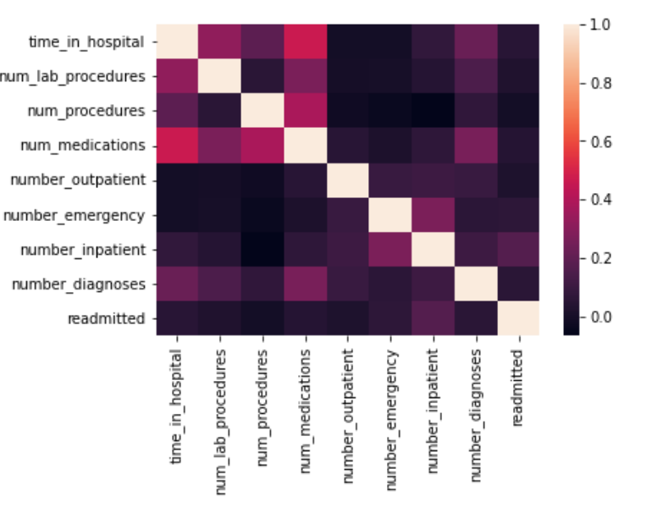
It shows that the column ‘number_in_patient’ is mostly correlated with the outpur readmitted. Might be patients who are admitted in the hospital have higher chance of readmission within 30 days.
Correlation Plot

Slide 6
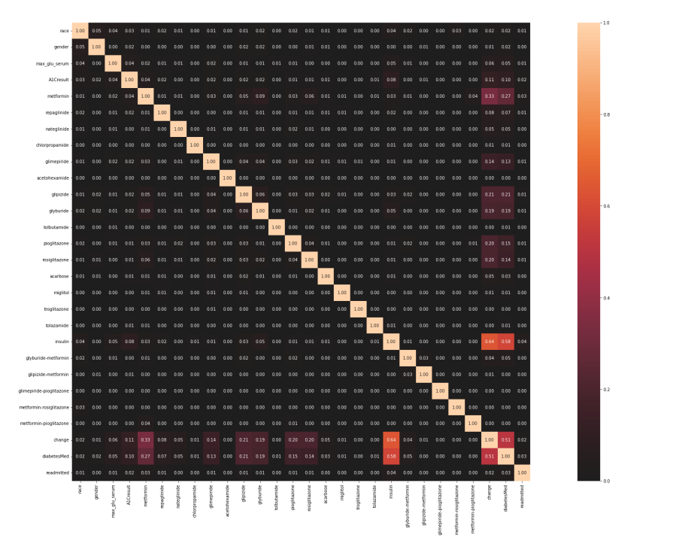
Association Plot
There is a little dependency among the independent features of the data which is a good sign to train the model.
The highest correlation is among the Features ‘insulin’ and ‘Medication Change’ which also highlights change in insulin dosage had significant effect on the readmission.
Also Features ‘diabetesMed’ and ‘insulin’ are closely correlated as Insulin is the most prescribed and prevalent medicine for diabetes

Slide 7
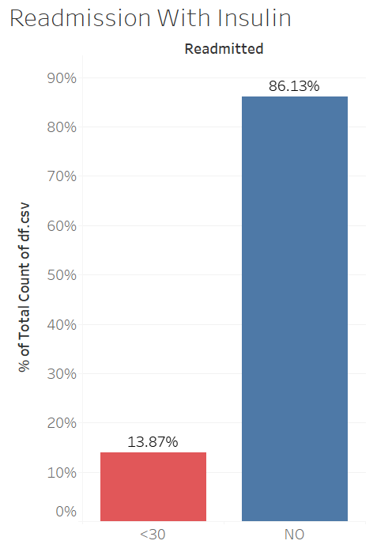
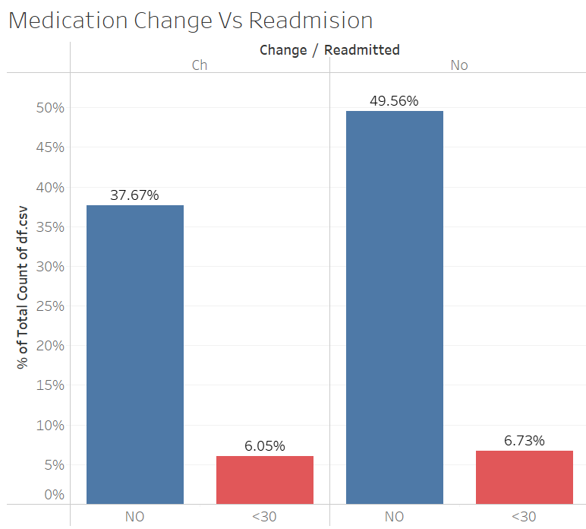
Readmission Statistical Analysis

Slide 8
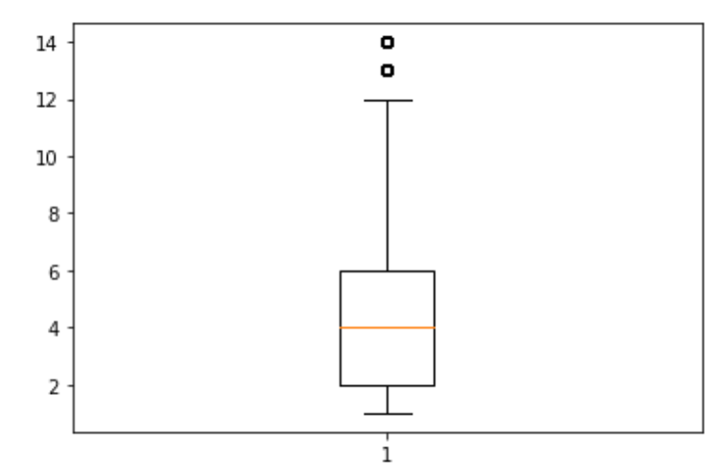
Outlier Analysis
Boxplots are plotted for each of the columns to observe the outlier’s presence. It has been observed that major portion of the numerical data lies within a range and there are no outliers that differ largely from the rest of the data
We can observe that values 12, 14 outside the 3 S.D from mean cannot be the outliers as there is possibility of people staying in hospitals for 12 or 14 days.

Slide 9
Feature Engineering
Column ‘medical_speciality’ has 73 unique categories of values. Using one-hot encoding would create columns equal to number of different categories. To avoid this top-10 categories of the ‘medical_speciality’ has been considered which have almost 93% of data.
‘Age’ column in the dataset consists of bins. To make it easy for the model to train ‘Age’ values have been converted to numerical values. Example: [70-80) is converted to 75
Label column ‘readmitted’ has ‘30’, ‘NO’ values initially. Since our class of interest is ‘30’.
Features ‘ encounter_id’, ‘patient_nbr’ are removed as they represent unique row and do not contribute to model building

Slide 10
Logistic Regression
Our base line model is chosen as Logistic Regression.
Logistic Regression is an algorithm that can be used to model the probability of a certain class.
Reason for selection of Logistic Regression as model - It is used when the data is linearly separable, independent, no outliers and the outcome is binary.
It provides the binary output using the sigmoid function.

Slide 11
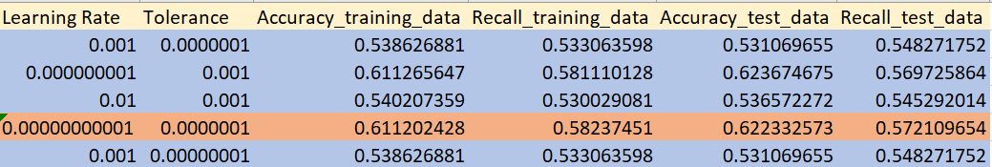
Model Performance
We tried multiple combinations of hyperparameters (i.e. learning rate and tolerance) and displayed some combinations to highlight the best and worst hyperparameters.
Our main metric of focus is Recall, as we must reduce the False Negatives in the data. The model has tolerance to predict class label ‘0’ as ‘1’ but not ‘1’ as ‘0’. Hence, reducing the occurrences of False Negatives results in an increase in the Recall value.
Since we have considered the balanced class label data, we can consider Accuracy as a performance metric. Keeping in mind the importance of both the metrics, we can clearly see that for learning rate = ‘0.00000000001’ and tolerance = ‘0.0000001’are fetching better accuracy and recall. So, we are using these hyperparameters in our final model which results in accuracy of 62.2 % and recall of 57.2 %

Slide 12
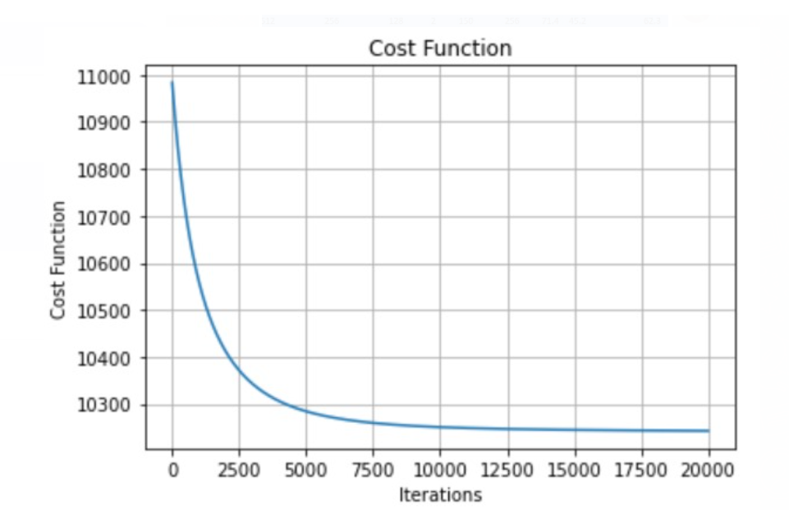
Cost Function Vs Iterations

Slide 13

Neural Networks
A neural network is a set of algorithms that attempts to recognize underlying relationships in a batch of data using a method that mimics how the human brain works. Neural networks, in this context, refer to systems of neurons that can be organic or artificial in nature.
We have used RELU activation function in our hidden layers, because the main reason why ReLu is used is because it is simple, fast, and empirically it seems to work well. Empirically, early papers observed that training a deep network with ReLu tended to converge much more quickly and reliably than training a deep network with sigmoid activation.
We have used Adam optimizer; it combines the best properties of the AdaGrad and RMSProp algorithms to provide an optimization algorithm that can handle sparse gradients on noisy problems. Adam is relatively easy to configure where the default configuration parameters do well on most problems.

Slide 14
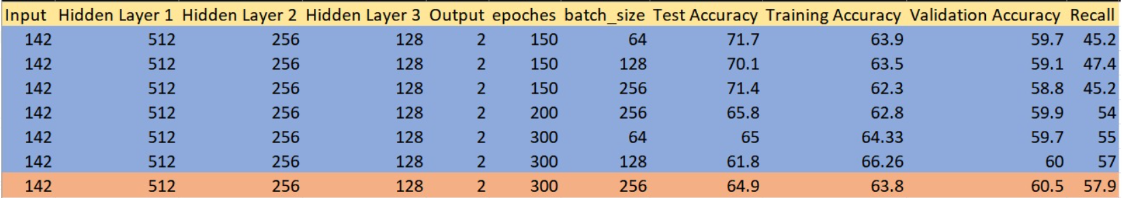
We tried different combinations of the number of neurons in hidden layers, number of epochs and batch size. Here, we can see that we achieved accuracy of around 72% in our first combination which is very high, but at the same time recall is 45% which is very low. As recall is important in our problem, we tuned some hyperparameters. In all combinations, we found that the best results are given by the last record in the abovementioned combinations. We achieved accuracy of 65% and recall of 58% which are better than the results obtained by our baseline model (Logistic Regression).

Slide 15
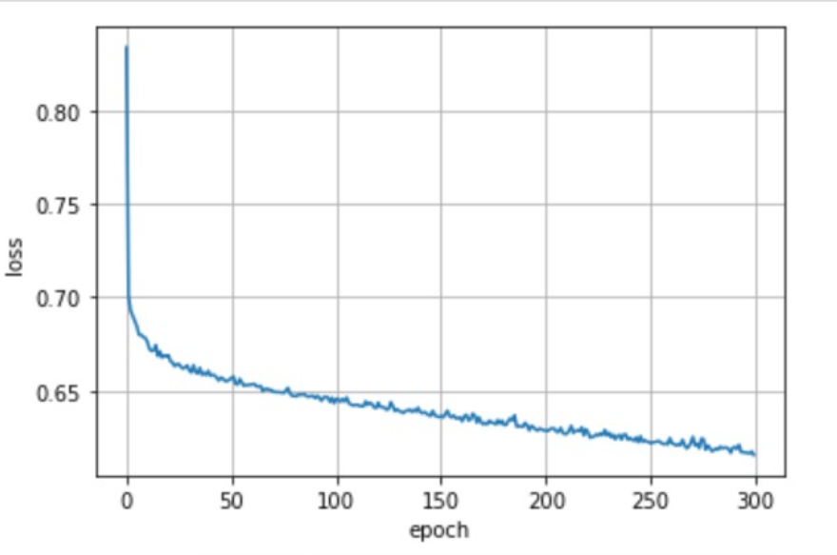
Training Loss Vs Epochs

Slide 16
Bias and Variance Tradeoff
Validation Set Approach: We have used validation dataset in our model without revealing our test data to the model. This way we can try different models with our validation data and predict the values of the test data with the best fit model. We have used 70% data as train and remaining 15% of data as test and other 15% of validation data
Random shuffling of data: Before train, test split we have random sampled the data which will avoid the case of training the data on only one set of class labels. Also, while training the data balanced data is considered in order not to train the model on biased data to overcome the generalization error
Hyper Parameter Tuning: We have evaluated the data on different combinations of Hyperparameters like learning rate and tolerance for logistic regression and Number of neurons in different hidden layers, batch size in Neural Network models, epochs. Tuning these hyperparameters helped in maximizing the model performance and minimizing the error

Slide 17
References
https://www.hindawi.com/journals/bmri/2014/781670/#B8
https://docs.google.com/spreadsheets/d/14oUegl5Bulxzy9z7i0RyI6wjOm4kUZyjxsJa7vF6diA/edit#gid=0
https://docs.google.com/spreadsheets/d/1MUAbyd26CdxM1UkhEJA6ggPH9Alcj1uyK5tBMKzdmIE/edit?usp=sharing
https://www.investopedia.com/terms/n/neuralnetwork.asp
https://stats.stackexchange.com/questions/126238/what-are-the-advantages-of-relu-over-sigmoid-function-in-deep-neural-networks
https://machinelearningmastery.com/adam-optimization-algorithm-for-deep-learning/

Slide 18
Thank You

